Slide 1
Robot Operating System – ROS
Practicalities

Slide 2

1
ROS Namespaces
2
ROS Namespaces Example
3
ROS Parameter Files
4
ROS Parameter Files Examples
Table of contents
5
ROS Custom Messages
6
ROS Custom Messages Examples
7
ROS Activity
8
Questions

Slide 3
Robot Operating System – ROS
Namespaces

Slide 4
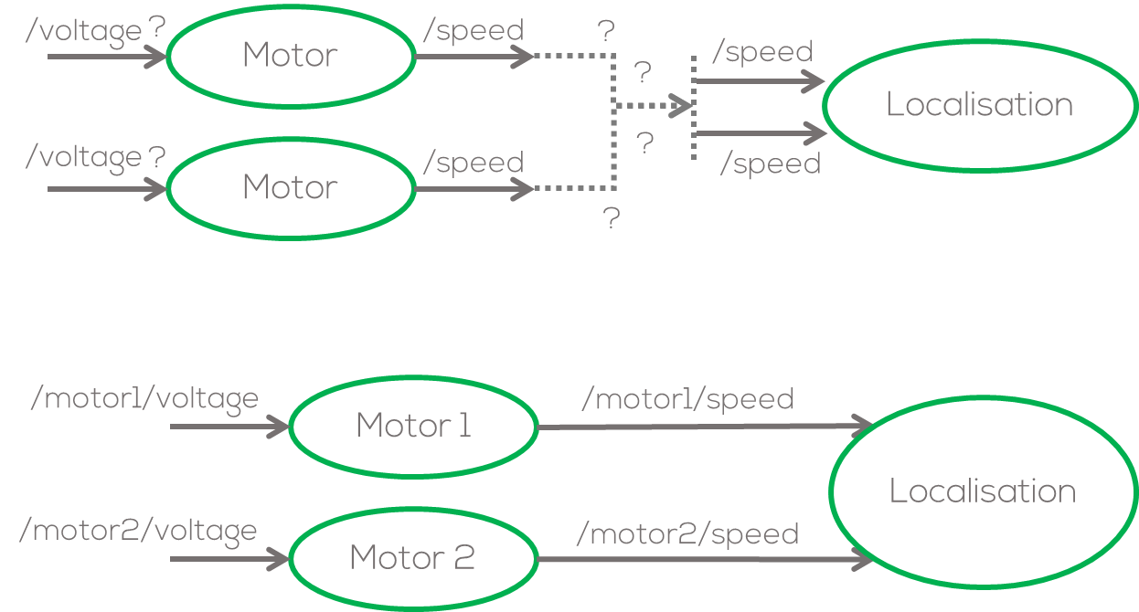
ROS Namespaces
Imagine the following problem: you have a node that simulates a motor, and you require to simulate two (or more) motors using the same code.
The problem in ROS will be the naming convention for the nodes and the topics to which the motor node subscribes, and where it publishes; since they will both be the same.
One simple solution will be to change the name of the nodes and topics manually by generating multiple .py files. For complex system this is not a good option. (What would happen if I require 10 motors?)
Namespaces then become the best option to deal with name collisions, when systems become more complex.

Slide 5
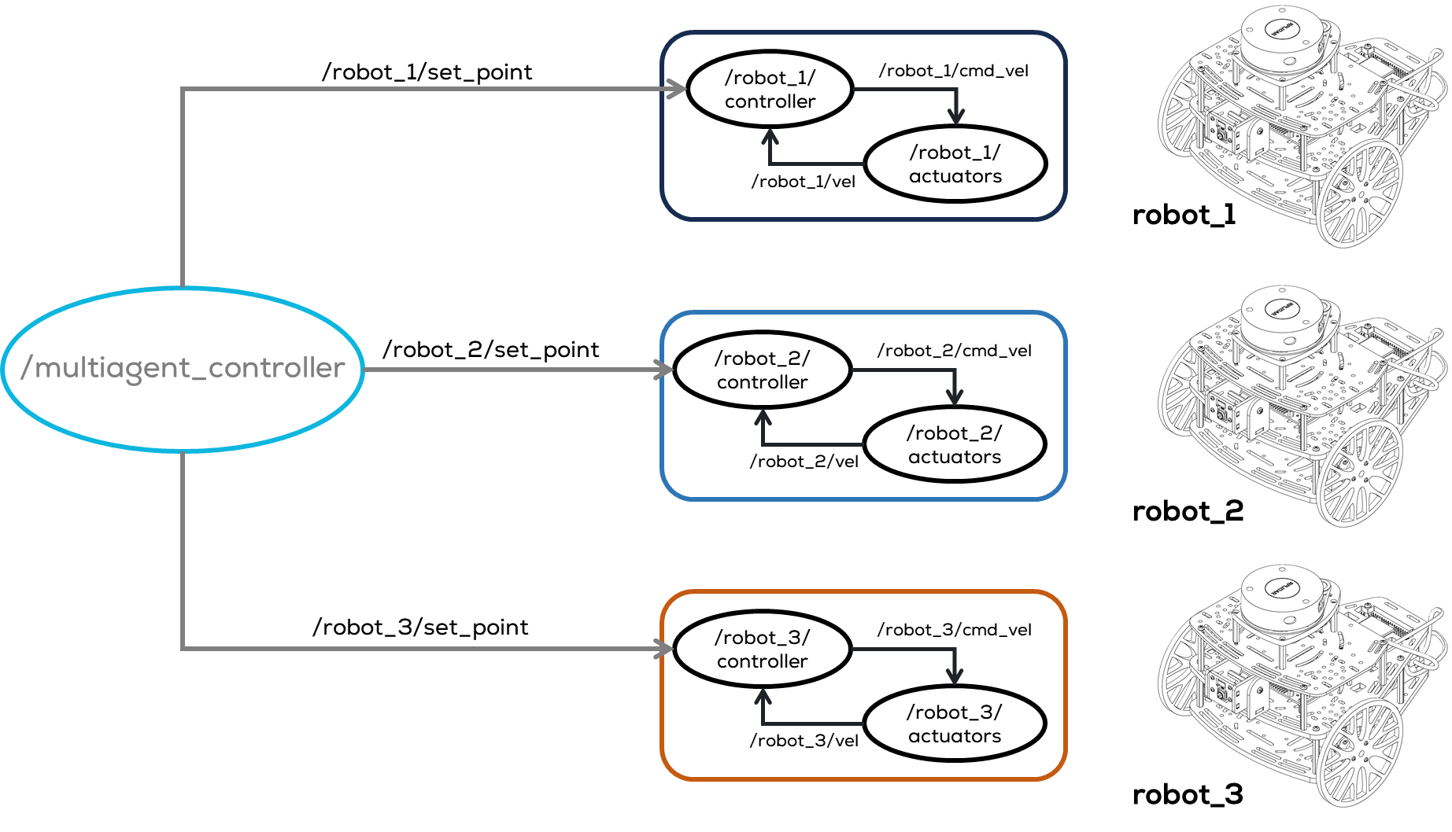
ROS Namespaces
A namespace in ROS can be viewed as a directory that contains items with different names.
The items can be nodes, topics or other namespaces (hierarchy).
There are several ways to define the namespaces. The easiest way is via the command line, which is very easy but not recommended for larger projects.
In this presentation, the launch file will be used to define the namespaces.

Slide 6
Activity 2
ROS Namespaces

Slide 7
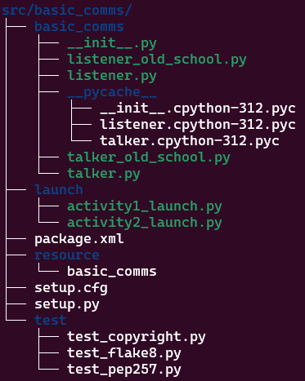
Activity 2 – ROS Namespaces
Requirements
This activity requires the previous talker and listener activities to be completed.
For this example, two talker nodes and two listener nodes will be generated using namespaces.
Create an activity2_launch.py file in the launch folder of the basic_comms package.
$ cd ~/ros2_ws/src/basic_comms/launch
$ touch activity2_launch.py
$ chmod +x activity2_launch.py

Slide 8
Activity 2 – ROS Namespaces
from launch import LaunchDescription
from launch_ros.actions import Node
def generate_launch_description():
talker1_node = Node(name="talker",
package='basic_comms',
executable='talker',
namespace='group1',
output='screen'
)
listener1_node = Node(name="listener",
package='basic_comms',
executable='listener',
namespace='group1',
output='screen'
)
talker2_node = Node(name="talker",
package='basic_comms',
executable='talker',
namespace='group2',
output='screen'
)
listener2_node = Node(name="listener",
package='basic_comms',
executable='listener',
namespace='group2',
output='screen'
)
l_d = LaunchDescription([talker1_node,listener1_node, talker2_node,listener2_node])
return l_d
Imports
Launch body
Launch body
Set launch content

Slide 9
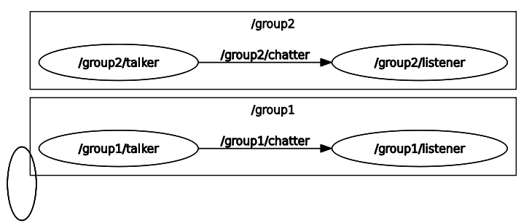

Activity 2 – ROS Namespaces
Build and run the newly created lunch file using colcon.
Open the rqt_graph to visualise the nodes
Tips
Add the rqt_graph to the launch file:
Results
$ cd ~/ros2_ws
$ colcon build
$ source install/setup.bash
$ ros2 launch basic_comms activity2_launch.py
$ ros2 run rqt_graph rqt_graph
rqt_graph_node = Node(name="rqt",
package='rqt_graph',
executable='rqt_graph',
output='screen'
)
l_d = LaunchDescription([talker1_node,listener1_node, talker2_node,listener2_node, rqt_graph_node])

Slide 10
Activity 2.1
ROS Namespaces 2

Slide 11
Activity 2.1 – ROS Namespaces 2
In the previous exercise, a namespace for each node was defined using the parameter
If the launch file contains many nodes, defining namespaces can become very difficult.
One solution is to call the entire launch file directly from another launch file (nested launch file) and assign a namespace so that every nested node will inherit that namespace.
Requirements
This activity requires the previous talker and listener activities to be completed.
For this example, two talker nodes and two listener nodes will be generated using namespaces.
A launch file will be to nest another launch file.
namespace= 'group1',

Slide 12
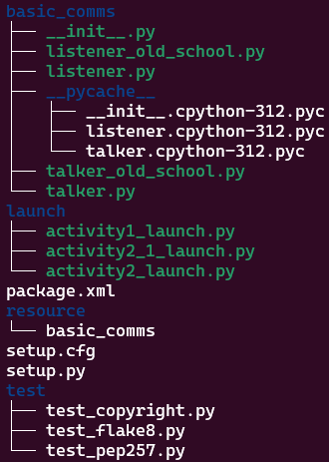
Activity 2.1 – ROS Namespaces 2
Create and open “activity2_1_launch.py” file in the launch folder of the basic_comms package.
Open the activity2_1_launch.py on a text editor.
$ cd ~/ros2_ws/src/basic_comms/launch
$ touch activity2_1_launch.py
$ chmod +x activity2_1_launch.py

Slide 13
Activity 2.1 – ROS Namespaces 2
#IMPORTS REQUIRED TO SET THE PACKAGE ADDRESS (DIRECTORIES)
import os
from ament_index_python.packages import get_package_share_directory
#iMPORTS REQUIRED FOR CALLING OTHER LAUNCH FILES (NESTING)
from launch import LaunchDescription
from launch.actions import IncludeLaunchDescription
from launch.launch_description_sources import PythonLaunchDescriptionSource
#IMPORTS REQUIRED TO PUSH A NAMESPACE (APPEND) A NAMESPACE TO A NESTED LAUNCH FILE
from launch.actions import GroupAction
from launch_ros.actions import PushRosNamespace
#INITIATE LAUNCH FILE
def generate_launch_description():
#USER VARIABLES
package = 'basic_comms' #Package to be launched
launch_file = 'activity1_launch.py' #Launch file to get a namespace
group1_ns = 'group1' #namespace to be used for group 1
group2_ns = 'group2' #namespace to be used for group 2
group3_ns = 'group3' #namespace to be used for group 3
#Get the address of the package
package_directory = get_package_share_directory(package)
#Get the address of the launch file
launch_file_path = os.path.join(package_directory, 'launch', launch_file)
#Set the launch file source for the group1 and group2
launch_source1 = PythonLaunchDescriptionSource(launch_file_path)
launch_source2 = PythonLaunchDescriptionSource(launch_file_path)
#Include the launch description for group1
talker_listener_launch_1 = IncludeLaunchDescription(launch_source1)
#Include the launch description for group2
talker_listener_launch_2 = IncludeLaunchDescription(launch_source2)
#Include the launch description for group3
#THIS IS ANOTHER WAY OF DOING THE PREVIOUS STEPS (MORE COMPACT) THE RESULTS ARE THE SAME
talker_listener_launch_3= IncludeLaunchDescription(
PythonLaunchDescriptionSource([os.path.join(
get_package_share_directory('basic_comms'), 'launch'),
'/activity1_launch.py'])
)
#SET NAMESPACE FOR ALL THE NODES INSIDE THE LAUNCH FILE
talker_listener_group1 = GroupAction(
actions=[PushRosNamespace(group1_ns),
talker_listener_launch_1,
]
)
talker_listener_group2 = GroupAction(
actions=[PushRosNamespace(group2_ns),
talker_listener_launch_2,
]
)
talker_listener_group3 = GroupAction(
actions=[PushRosNamespace(group3_ns),
talker_listener_launch_3,
]
)
#LAUNCH THE DESCRIPTION
l_d = LaunchDescription([talker_listener_group1, talker_listener_group2, talker_listener_group3])
return l_d

Slide 14
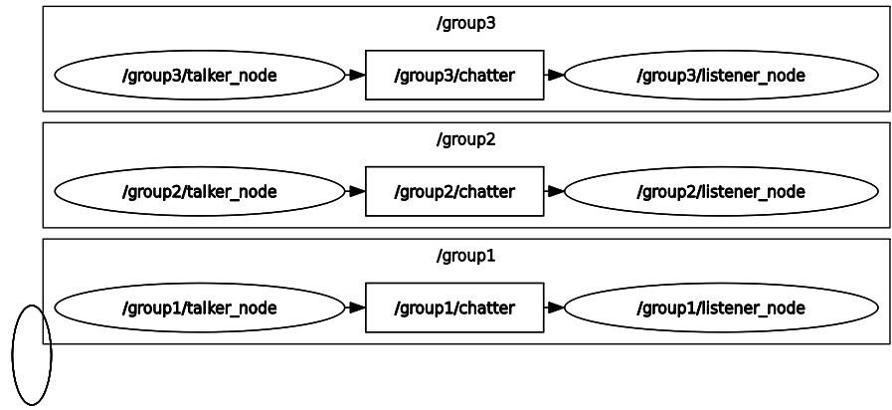
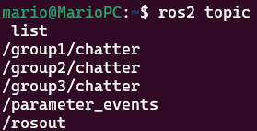
Activity 2.1 – ROS Namespaces 2
Build and run the newly created lunch file using colcon.
Open in another terminal the rqt_graph to visualise the nodes
Results
$ cd ~/ros2_ws
$ colcon build
$ source install/setup.bash
$ ros2 launch basic_comms activity2_1_launch.py
$ ros2 run rqt_graph rqt_graph

Slide 15
Robot Operating System – ROS
Parameter Files

Slide 16
ROS Parameters
Any software application, especially in robotics requires parameters.
Parameters are variables with some predefined values that are stored in a separate file or hardcoded in a program such that the user has easy access to change their value.
At the same time parameters can be shared amongst different programs to avoid rewriting them or recompiling the nodes (C++)
In robotics, parameters are used to store values requiring tunning, robot names, sampling times or flags.
ROS encourage the usage of parameters to avoid making dependencies or rewriting nodes.

Slide 17
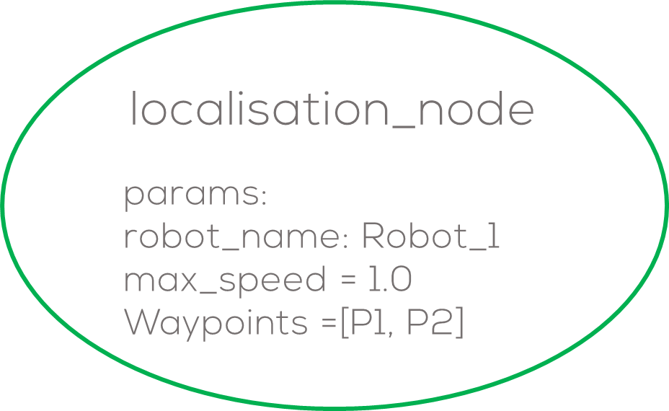
ROS Parameters
ROS parameters are stored in each node.
Nodes retrieve parameters at startup and runtime.
The lifetime of a parameter is the same as the node.
These parameters are used to configure nodes, e.g., robot constants, starting values, controller parameters, etc.
ROS can only use determined types of parameters such as:
Parameters are composed of a key, value and descriptor.
key value descriptor
<Name> <Value> <Description of the parameter (empty)>
bool, int64, float64, string, byte[], bool[], int64[], float64[] or string[]

Slide 18
Activity 3
Parameters

Slide 19
Activity – Parameters
Create a package called basic_comms_params, and create a talker_params.py file
$ cd ~/ros2_ws/src/
$ ros2 pkg create --build-type ament_python --license Apache-2.0 basic_comms_params --dependencies rclpy
$ touch basic_comms_params/basic_comms_params/talker.py
$ chmod +x basic_comms_params/basic_comms_params/talker_params.py

Slide 20
ROS Parameters
Parameters Command Line
To list the parameters belonging to available nodes
To display the type and current value of a parameter
To change a parameter’s value at runtime (current session)
Dump all of a node’s current parameter values into a file to save them
You can load parameters from a file to a currently running node
To start the same node using your saved parameter values
$ ros2 param dump <node_name>
$ ros2 param list
$ ros2 param get <node_name> <parameter_name>
$ ros2 param load <node_name> <parameter_file>
$ ros2 param set <node_name> <parameter_name> <value>
$ ros2 run <package_name> <executable_name> --ros-args --params-file <file_name>

Slide 21
Activity – Parameters
import rclpy
from rclpy.node import Node
class MinimalParam(Node):
def __init__(self):
super().__init__('minimal_param_node')
self.declare_parameter('my_parameter', 'world')
self.timer = self.create_timer(1, self.timer_callback)
def timer_callback(self):
my_param = self.get_parameter('my_parameter').get_parameter_value().string_value
self.get_logger().info('Hello %s!' % my_param)
my_new_param = rclpy.parameter.Parameter(
'my_parameter',
rclpy.Parameter.Type.STRING,
'world'
)
all_new_parameters = [my_new_param]
self.set_parameters(all_new_parameters)
def main():
rclpy.init()
node = MinimalParam()
rclpy.spin(node)
if __name__ == '__main__':
main()

Slide 22
Activity – Parameters
Add an entry point in the setup.py file
entry_points={
'console_scripts': [
'talker_params = basic_comms_params.talker_params:main'
],
Perform a colcon build on the workspace
Open two terminals and source the workspace

Slide 23
Parameters via console
Terminal 1
Run the node with
ros2 run basic_comms_params talker_params
Terminal 2
Check the available params
ros2 param list
Change the parameter with the console
ros2 param set /minimal_param_node my_parameter friends

Slide 24
Parameters via a launch file
Create a chatter_params_launch.py file in the launch folder of the basic_comms_params package.
$ cd ~/ros2_ws/src/basic_comms_params/launch
$ touch chatter_params_launch.py
$ chmod +x chatter_params_launch.py

Slide 25
Parameters via a launch file
from launch import LaunchDescription
from launch_ros.actions import Node
def generate_launch_description():
return LaunchDescription([
Node(
package='basic_comms_params',
executable='talker_params',
output='screen',
emulate_tty=True,
parameters=[
{'my_parameter': 'buddies'}
]
)
])

Slide 26
Parameters via a launch file
Modify the setup.py file to include the launch files
data_files=[
# ...
(os.path.join('share', package_name), glob('launch/*launch.[pxy][yma]*')),
]
Build the workspace, source it, and launch the node we just created.
$ cd ~/ros2_ws/
$ colcon build
$ source install/setup.bash
$ ros2 launch basic_comms_params chatter_params_launch.py

Slide 27
Parameter files
The previous way of defining parameters is very useful, but for the case when having to define many different parameters this can become very inefficient.
ROS offers the capability to define parameters using a parameter file.
These types of files are configuration files, written in YAML. These files are commonly used in other languages to set up parameters or variables.
The way to define the hierarchy of a parameter, like in python depends on spacing.
node_1:
ros__parameters:
some_text: "abc"
node_2:
ros__parameters:
int_number: 27
float_param: 45.2
node_3:
ros__parameters:
int_number: 45
Notes:
Parameters — rclpy 0.6.1 documentation (ros2.org)
ROS2 YAML For Parameters - The Robotics Back-End (roboticsbackend.com)

Slide 28
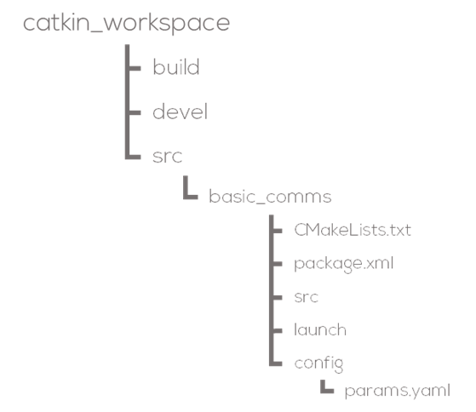
Parameter files
The same as you would put your launch files into a launch/ folder, you can put all your YAML config files into a config/ folder, directly at the root of your package.
Inside the config folder create a file named “params.yaml” (the file can have any name just make sure follow a convention properly).

Slide 29
Activity – Parameter file
Navigate to your workspace and go to the src folder
Add the following line to the console scripts in the setup.py file
'node_params = basic_comms_params.node_params:main'
$ cd ~/ros2_ws/
$ touch src/basic_comms_params/launch/node_params_launch.py
$ chmod +x src/basic_comms_params/launch/ node_params_launch.py
$ mkdir src/basic_comms_params/config
$ touch src/basic_comms_params/config/params.yaml
$ touch src/basic_comms_params/basic_node_params/node_params.py
$ chmod +x src/basic_comms_params/basic_node_params/node_params.py

Slide 30
Parameter file
example_node_params:
ros__parameters:
bool_value: True
int_number: 5
float_number: 3.14
str_text: "Hello Universe"
bool_array: [True, False, True]
int_array: [10, 11, 12, 13]
float_array: [7.5, 400.4]
str_array: ['Nice', 'more', 'params']
bytes_array: [0x01, 0xF1, 0xA2]
nested_param:
another_int: 7
another_float: 7.0

Slide 31
Load a YAML config file for a node
import rclpy
from rclpy.node import Node
class TestYAMLParams(Node):
def __init__(self):
super().__init__('example_node_params')
self.declare_parameters(
namespace='',
parameters=[
('bool_value', rclpy.Parameter.Type.BOOL), ('int_number', rclpy.Parameter.Type.INTEGER),
('float_number', rclpy.Parameter.Type.DOUBLE), ('str_text', rclpy.Parameter.Type.STRING),
('bool_array', rclpy.Parameter.Type.BOOL_ARRAY), ('int_array', rclpy.Parameter.Type.INTEGER_ARRAY),
('float_array', rclpy.Parameter.Type.DOUBLE_ARRAY), ('str_array', rclpy.Parameter.Type.STRING_ARRAY),
('bytes_array', [0x00]), ('nested_param.another_int', rclpy.Parameter.Type.INTEGER )
])
def main(args=None):
rclpy.init(args=args)
node = TestYAMLParams()
rclpy.spin(node)
node.destroy_node()
rclpy.shutdown()
if __name__ == '__main__':
main()

Slide 32
Launch file
import os
from ament_index_python.packages import get_package_share_directory
from launch import LaunchDescription
from launch_ros.actions import Node
def generate_launch_description():
ld = LaunchDescription()
config = os.path.join(
get_package_share_directory('basic_comms_params'),
'config',
'params.yaml'
)
node=Node(
package = 'basic_comms_params',
name = 'example_node_params',
executable = 'node_params',
parameters = [config]
)
ld.add_action(node)
return ld

Slide 33
Robot Operating System – ROS
Custom Messages

Slide 34
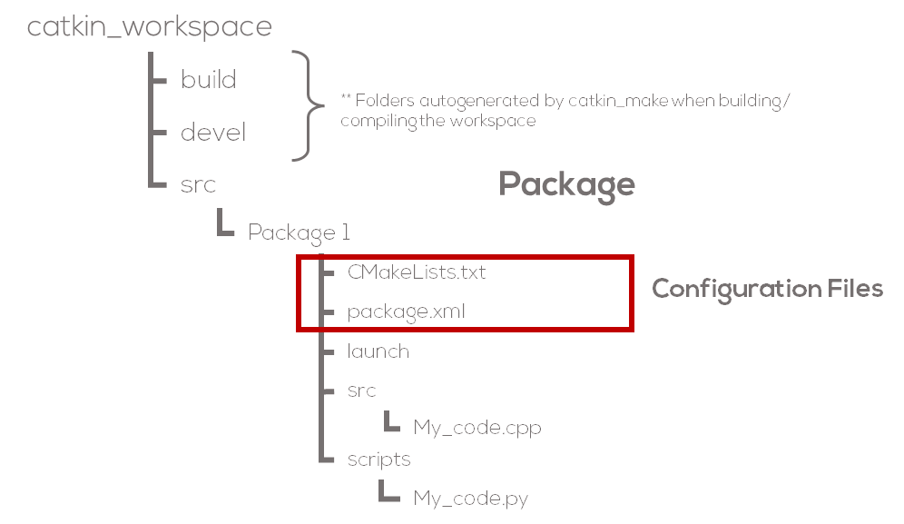
Configuration Files
Packages are the “buildable and redistributable units” of ROS code. Therefore, to build a package it is necessary to build the entire package as one piece.
In most projects, the user would require to build multiple packages to group nodes, libraries and other resources for different purposes/functionalities.
Colcon requires different configuration files to properly define the dependencies and properties (meta information) for the different packages.
Such packages are called CMakeLists.txt and package.xml

Slide 35
Catkin and CMakeLists Files
Compilers and executables usually require libraries, external files or flags to be able to compile and run a program.
Build tools, describe the setup of the project (set of rules and commands) at a user level to generate the specific flags and paths required by the program to run.
In Linux these build tools are commonly known as Make files.
Make files sometimes require information from the system, like paths to libraries, dependencies, targets to be built, locations, etc.
When sharing a project, the paths to those libraries may change.
CMake is a tool (build system generator) that allows the user to deal with the issue by searching for the library paths and generating the flags in other machines to generate the make file.
CMake tool only works with one project at a time.
CMake uses CMakeLists files to work.

Slide 36
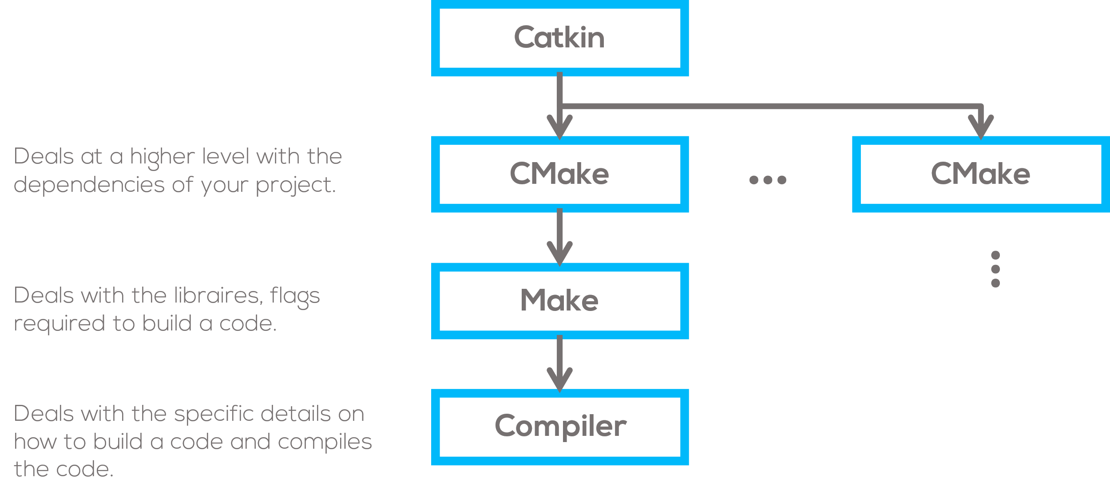
Catkin and CMake Files
ROS is a very large collection of packages. That means lots of independent packages which depend on each other, utilize various programming languages, tools, and code organization conventions.
The build process for a target in some package may be completely different from the way another target is built.
To coordinate all the CMake files across projects the Colcon tool was created. Colcon is the official build system of ROS
Colcon specifically tries to improve development on large sets of related packages in a consistent and conventional way.

Slide 37
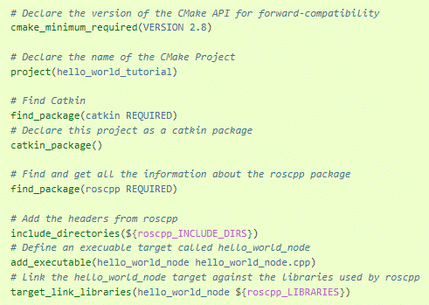
CMakeLists Structure
Required CMake Version (cmake_minimum_required)
Package Name (project())
Find other CMake/Catkin packages needed for build (find_package())
Enable Python module support (catkin_python_setup())
Message/Service/Action Generators (add_message_files(), add_service_files(), add_action_files())
Invoke message/service/action generation (generate_messages())
Specify package build info export (catkin_package())
Libraries/Executables to build (add_library()/add_executable()/target_link_libraries())
Tests to build (catkin_add_gtest())
Install rules (install())
CMakeLists.txt Example

Slide 38
CMake Files
When using Python, compared with C++, CMakeLists files are used to define the list of dependencies or modules, create custom messages, installation rules or when using a client/server model.
When using C++, CmakeLists can become more “complex” because you will need to declare more parameters, flags and libraries into the file.
More information about CMakeLists when using C++ can be found here and here.
Examples of CMakeLists files can be found here.
Notes:
The best way of learning CMakeLists is to view other people CMakeLists or understanding how Cmake works from the CMake website.
The file generated by catkin_create_pkg is well commented, so reading the file helps explain what you need to do.
Change the line with find_package(catkin REQUIRED COMPONENTS <dependencies>...) so that the <dependencies> match whatever is declared as a <depend> in your package.xml
There is a section in the auto-generated CMakeLists.txt dedicated to installation. Lines in this section must be modified to properly be able to install your package.
You should also change the catkin_package line to include the name of your catkin package dependencies
If you use custom .msg or .srv files, there are further lines to uncomment so that the proper code will be generated. There are also lines in package.xml that should be edited.

Slide 39
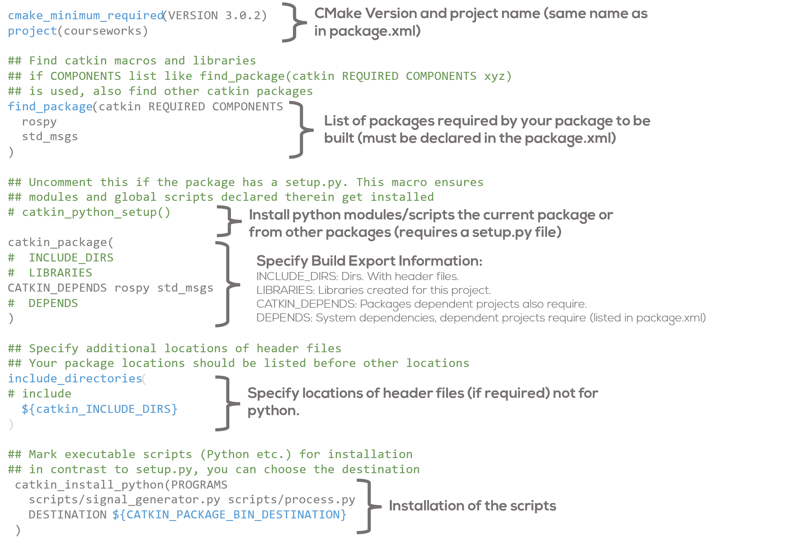
CMake Files

Slide 40
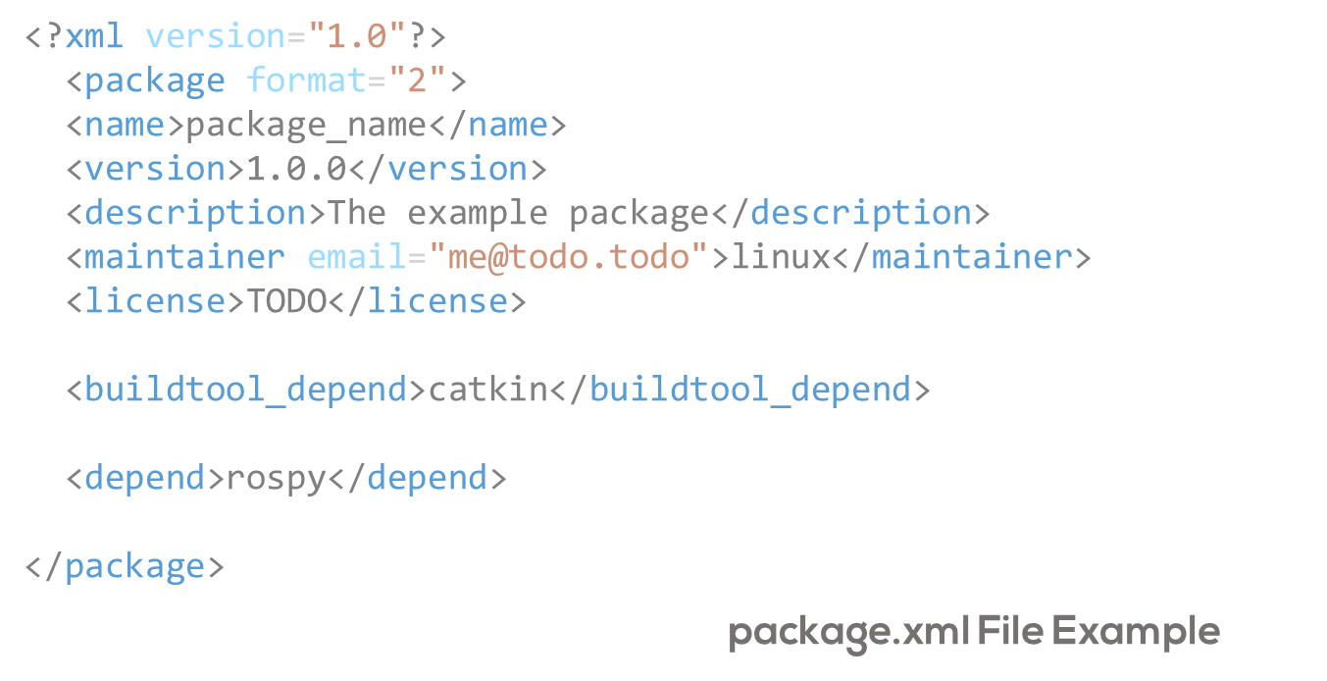
Package.xml File
Package manifest file.
Contains the metadata of the package.
XML File that must be included with any catkin-compliant package.
Defines the properties about the package such as the package name, version numbers, authors, maintainers, and dependencies on other catkin packages.
More information about Package.xml files can be found here, here and here.

Slide 41
Package.xml File Dependencies
exec_depend: Packages required at runtime. The most common dependency for a python-only package. If your package or launchfile imports/runs code from another package.
build_depend: Package required at build time. Python packages usually do not require this. Some exceptions is when you depend upon messages, services or other packages.
build_export_depend: Specify which packages are needed to build libraries against this package. This is the case when you transitively include their headers in public headers in this package
Notes:
Your CMakeLists.txt need not specify Python-only dependencies. They are resolved automatically via sys.path.
The dependencies declared in the manifest are not used in the build process. if you omit them here, you likely won’t see any error messages until you distribute your package to others who try to build it without having the required packages installed.

Slide 42
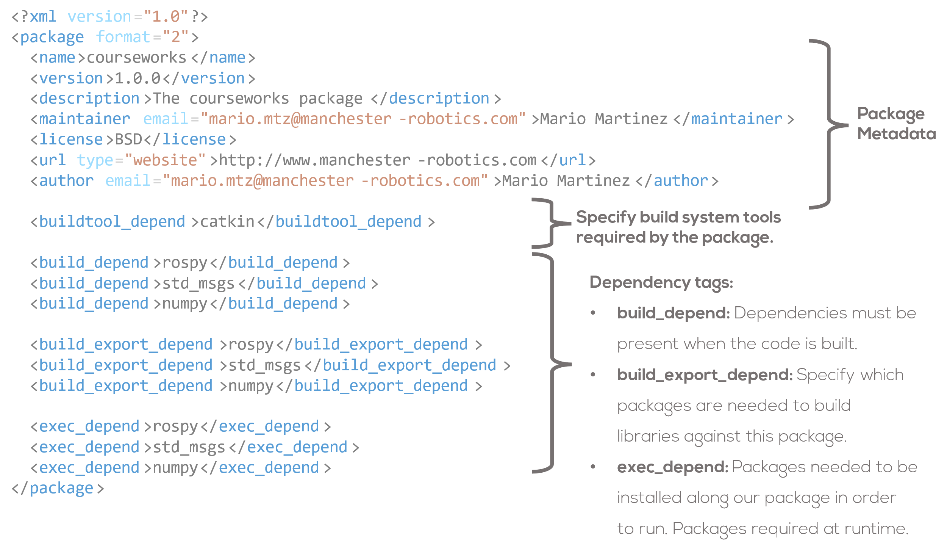
Package.xml File Dependencies

Slide 43
ROS Custom messages
ROS has some predefined messages like the std_messages, geometric_messages, etc.
Sometimes, the message structures are required to be altered for a custom application.
ROS allows the user to customise the messages and create new messages.
Custom messages are a way to personalise your own messages for a specific purpose or application.
Custom messages are created by the user, and must be linked to the package where they will be used.
More information here, here and here .

Slide 44
ROS Custom messages
For this example, a new message will be generated to contain two different values of data.
Two types of message will be used for the message.
For this example, only one topic will be necessary, and the message will include the information that describes the position and radius of a sphere

Slide 45
Activity – Message interfaces
Navigate to your workspace and go to the src folder
Create a new package
Open the Sphere.msg file and write the following
$ cd ~/ros2_ws/src/
$ ros2 pkg create --build-type ament_cmake --license Apache-2.0 srv_int
$ cd srv_int
$ mkdir msg
$ touch msg/Sphere.msg
geometry_msgs/Point center
float64 radius

Slide 46
Activity – Message interfaces
Open CMakeLists.txt and add the following lines
Do the same inside package.xml
find_package(geometry_msgs REQUIRED)
find_package(rosidl_default_generators REQUIRED)
rosidl_generate_interfaces(${PROJECT_NAME}
"msg/Sphere.msg"
DEPENDENCIES geometry_msgs
)
<depend>geometry_msgs</depend>
<buildtool_depend>rosidl_default_generators</buildtool_depend>
<exec_depend>rosidl_default_runtime</exec_depend>
<member_of_group>rosidl_interface_packages</member_of_group>

Slide 47
Activity – Message interfaces
Build the workspace and source it
Validate that the sphere message has been properly created
$ colcon build
$ source install/setup.bash
$ ros2 interface show srv_int/msg/Sphere

Slide 48
Activity – Message interfaces
Navigate to your workspace and go to the src folder
Create a new package
Open the sphere_node.py file and write the following
$ cd ~/ros2_ws/src/
$ ros2 pkg create --build-type ament_python --license Apache-2.0 sphere_msgs --node-name sphere_node --dependencies geometry_msgs srv_int

Slide 49
import rclpy
from rclpy.node import Node
from srv_int.msg import Sphere
import numpy as np
class CustomMsgPublisher(Node):
def __init__(self):
super().__init__('custom_msg_node')
self.pub = self.create_publisher(Sphere, 'sphere_position', 10)
self.timer_period = 0.1
self.timer = self.create_timer(self.timer_period, self.timer_callback)
self.x = 0
self.y = 0
self.z = 0
self.r = 1.5
self.time = 0
self.get_logger().info('Custom Sphere msg initialized')
def timer_callback(self):
msg = Sphere()
self.r = 1.5 + 0.5*np.sin(self.time)
self.time += self.timer_period
msg.radius = self.r
self.pub.publish(msg)
def main(args=None):
rclpy.init(args=args)
c_m_p = CustomMsgPublisher()
rclpy.spin(c_m_p)
c_m_p.destroy_node()
rclpy.shutdown()
if __name__ == '__main__':
main()

Slide 50
Activity – Message interfaces
You have already solved the dependencies since you built the package
Build your workspace and source it
Check the behavior by using echo
Plot the radius using rqt_plot
$ colcon build
$ source install/setup.bash
$ ros2 run sphere_msgs sphere_node
$ ros2 topic echo /sphere_position
$ ros2 run rqt_plot rqt_plot

Slide 51
Services
Services are another method of communication for nodes in the ROS graph.
A service is a request/response pattern where a client makes a request to a node providing the service and the service processes the request and generates a response.
While topics allow nodes to subscribe to data streams and get continual updates, services only provide data when they are specifically called by a client.
Notes:
You generally don’t want to use a service for continuous calls; topics or even actions would be better suited.

Slide 52
Services

Slide 53
Services

Slide 54
Services
To find out the type of a service
ros2 service type <service_name>
To see the types of all the active services
ros2 service list -t
To find all the services of a specific type
ros2 service find <type_name>
To know the structure of the input arguments of a service
ros2 interface show <type_name>
To call a service
ros2 service call <service_name> <service_type> <arguments>

Slide 55
Topics vs Services
Topics
Should be used for continuous data streams (sensor data, robot state, …).
Are for continuous data flow. Data might be published and subscribed at any time independent of any senders/receivers. Many to many connection. Callbacks receive data once it is available. The publisher decides when data is sent.
Services
Should be used for remote procedure calls that terminate quickly, e.g. for querying the state of a node or doing a quick calculation.
They should never be used for longer running processes, in particular processes that might be required to preempt if exceptional situations occur and they should never change or depend on state to avoid unwanted side effects for other nodes.
Simple blocking call. Mostly used for comparably fast tasks as requesting specific data. Semantically for processing requests.

Slide 56
Activity – Service interfaces
Navigate to your workspace and go to the src folder. Then go to the srv_int package
Open the AddTwoInts.srv file and write the following
$ cd ~/ros2_ws/src/
$ ros2 pkg create --build-type ament_cmake --license Apache-2.0 srv_int
$ cd srv_int
$ mkdir srv
$ touch srv/AddTwoInts.srv
int64 a
int64 b
---
int64 sum

Slide 57
Activity – Service interfaces
Open CMakeLists.txt and add the following lines
Do the same inside package.xml
find_package(geometry_msgs REQUIRED)
find_package(rosidl_default_generators REQUIRED)
rosidl_generate_interfaces(${PROJECT_NAME}
"msg/Sphere.msg"
"srv/AddTwoInts.srv"
DEPENDENCIES geometry_msgs
)
<depend>geometry_msgs</depend>
<buildtool_depend>rosidl_default_generators</buildtool_depend>
<exec_depend>rosidl_default_runtime</exec_depend>
<member_of_group>rosidl_interface_packages</member_of_group>

Slide 58
Activity – Service interfaces
Build the workspace and source it
Validate that the sphere message has been properly created
$ colcon build
$ source install/setup.bash
$ ros2 interface show srv_int/srv/AddTwoInts

Slide 59
Activity – Message interfaces
Navigate to your workspace and go to the src folder
Create a new package, create server and client python files
Modify the service_server.py and service_client.py files and write the following
$ cd ~/ros2_ws/src/
$ ros2 pkg create --build-type ament_python --license Apache-2.0 srv_example --dependencies rclpy srv_int
$ touch src/srv_example/srv_example/service_server.py
$ touch src/srv_example/srv_example/service_client.py
$ chmod +x src/srv_example/srv_example/*.py

Slide 60
service_server.py
from srv_int.srv import AddTwoInts
import rclpy
from rclpy.node import Node
class MinimalService(Node):
def __init__(self):
super().__init__('minimal_service')
self.srv = self.create_service(AddTwoInts, 'add_two_ints', self.add_two_ints_callback)
def add_two_ints_callback(self, request, response):
response.sum = request.a + request.b
self.get_logger().info('Incoming request\na: %d b: %d' % (request.a, request.b)) return response
def main():
rclpy.init()
minimal_service = MinimalService()
rclpy.spin(minimal_service)
rclpy.shutdown()
if __name__ == '__main__':
main()

Slide 61
service_client.py
import sys
from srv_int.srv import AddTwoInts
import rclpy
from rclpy.node import Node
class MinimalClientAsync(Node):
def __init__(self):
super().__init__('minimal_client_async')
self.cli = self.create_client(AddTwoInts, 'add_two_ints')
while not self.cli.wait_for_service(timeout_sec=1.0):
self.get_logger().info('service not available, waiting again...')
self.req = AddTwoInts.Request()
def send_request(self, a, b):
self.req.a = a
self.req.b = b
self.future = self.cli.call_async(self.req)
rclpy.spin_until_future_complete(self, self.future)
return self.future.result()
def main():
rclpy.init()
minimal_client = MinimalClientAsync()
response = minimal_client.send_request(int(sys.argv[1]), int(sys.argv[2]))
minimal_client.get_logger().info(‘Result of add_two_ints: for %d + %d = %d’ % (int(sys.argv[1]), int(sys.argv[2]), response.sum))
minimal_client.destroy_node()
rclpy.shutdown()
if __name__ == '__main__':
main()

Slide 62
Entry points
Modify the entry points in the setup.py file such that
entry_points={
'console_scripts': [
'service = srv_example.service_server:main',
'client = srv_example.service_client:main',
],
},

Slide 63
Activity – Message interfaces
You have already solved the dependencies since you built the package
Build your workspace and source it. Then run the server
In another terminal, source the workspace. Then send a client request
$ colcon build
$ source install/setup.bash
$ ros2 run srv_example service
$ source install/setup.bash
$ ros2 run srv_example client -23 11

Slide 64


Q&A
Questions?

Slide 65
Thank You
Robotics For Everyone

Slide 66
T&C
Terms and conditions

Slide 67
Terms and conditions
THE PIECES, IMAGES, VIDEOS, DOCUMENTATION, ETC. SHOWN HERE ARE FOR INFORMATIVE PURPOSES ONLY. THE DESIGN IS PROPRIETARY AND CONFIDENTIAL TO MANCHESTER ROBOTICS LTD. (MCR2). THE INFORMATION, CODE, SIMULATORS, DRAWINGS, VIDEOS PRESENTATIONS ETC. CONTAINED IN THIS PRESENTATION IS THE SOLE PROPERTY OF MANCHESTER ROBOTICS LTD. ANY REPRODUCTION, RESELL, REDISTRIBUTION OR USAGE IN PART OR AS A WHOLE WITHOUT THE WRITTEN PERMISSION OF MANCHESTER ROBOTICS LTD. IS STRICTLY PROHIBITED.
THIS PRESENTATION MAY CONTAIN LINKS TO OTHER WEBSITES OR CONTENT BELONGING TO OR ORIGINATING FROM THIRD PARTIES OR LINKS TO WEBSITES AND FEATURES IN BANNERS OR OTHER ADVERTISING. SUCH EXTERNAL LINKS ARE NOT INVESTIGATED, MONITORED, OR CHECKED FOR ACCURACY, ADEQUACY, VALIDITY, RELIABILITY, AVAILABILITY OR COMPLETENESS BY US.
WE DO NOT WARRANT, ENDORSE, GUARANTEE, OR ASSUME RESPONSIBILITY FOR THE ACCURACY OR RELIABILITY OF ANY INFORMATION OFFERED BY THIRD-PARTY WEBSITES LINKED THROUGH THE SITE OR ANY WEBSITE OR FEATURE LINKED IN ANY BANNER OR OTHER ADVERTISING.

